Slide 1

Team 277
Sean D Kim, Tiffany Lee, Stella Kim
Notes:
Tiffany

Slide 2
Background
Original Project Proposal
Briefcase: Portfolio Webapp for Art Majors
Important Functionalities
Web application platform that is UI/UX friendly to art students by generating professional portfolios for them.
Users can manage their media by groups or projects.
Users can build their portfolios by adding their artwork on top of our built-in templates
Users can drag-and-drop the components for customization.
Notes:
Tiffany

Slide 3
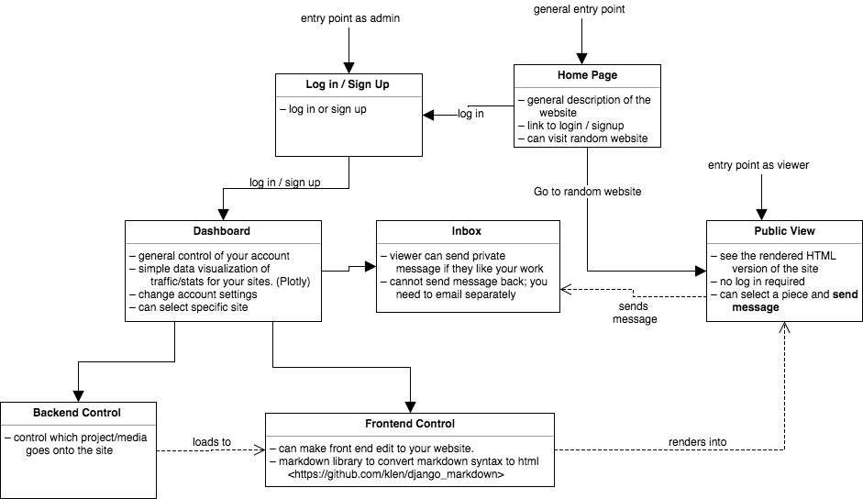
Overview
Notes:
Sean

Slide 4
Original Goal for Sprint 1
Pipeline Setup
Gulp.js (Tiffany)
javascript, CSS libraries (Tiffany)
Back-end
Creating Model (Stella / Sean)
Make API (Sean)
Notes:
Stella

Slide 5
Original Goal for Sprint 1 continued
Front-end
Create HTML template for all pages (Tiffany)
Create CSS styling for all pages (Tiffany)
User Account
Create Login/Registration flow (Stella)
Create User Profile and allowing editing account information (Stella)
Notes:
Stella

Slide 6
Did we meet the Goal?
Yes, and even better !
We got to head-start Sprint 2
Dashboard
Create user specific dashboard (Stella)
Project Editor (Backend Control)
Add/Edit projects and media (Stella / Sean)
Site Editor (Frontend Control)
Working on making customizable form (Tiffany / Sean)
Notes:
Stella

Slide 7
Live Demo
We know you all have been waiting for this…
the LIVE DEMO!
Notes:
Sean

Slide 8
Challenges we have faced / are facing right now
Separating the functionality between Project Editor and Site Editor
Project Editor -> Files/Media Library
Site Editor -> actual site/portfolio editor
Coming up with UI that is intuitive to use
Referencing Squarespace, Medium
Site Editor
User should be able to drag and drop images onto the form
User edits html => store in database => rerender it for public site
Notes:
Sean

Slide 9
Goal for Sprint 2
Dashboard
Monitor visitor to each user’s website
Create infographics for site statistics
Page Customization
Create components that can be added to page
Allow user to use templates
Head-start Sprint 3
Portfolio Editing / Page Customization
Notes:
Tiffany

Slide 10
Any Questions?

